Slide 1
Week 6 Recitation
BIOCHEM 5722
Molecular orbitals and biochemistry

Slide 2
Objectives
Work through the recitation questions on Carmen.
Introduce concepts relevant to the practice problems.

Slide 3
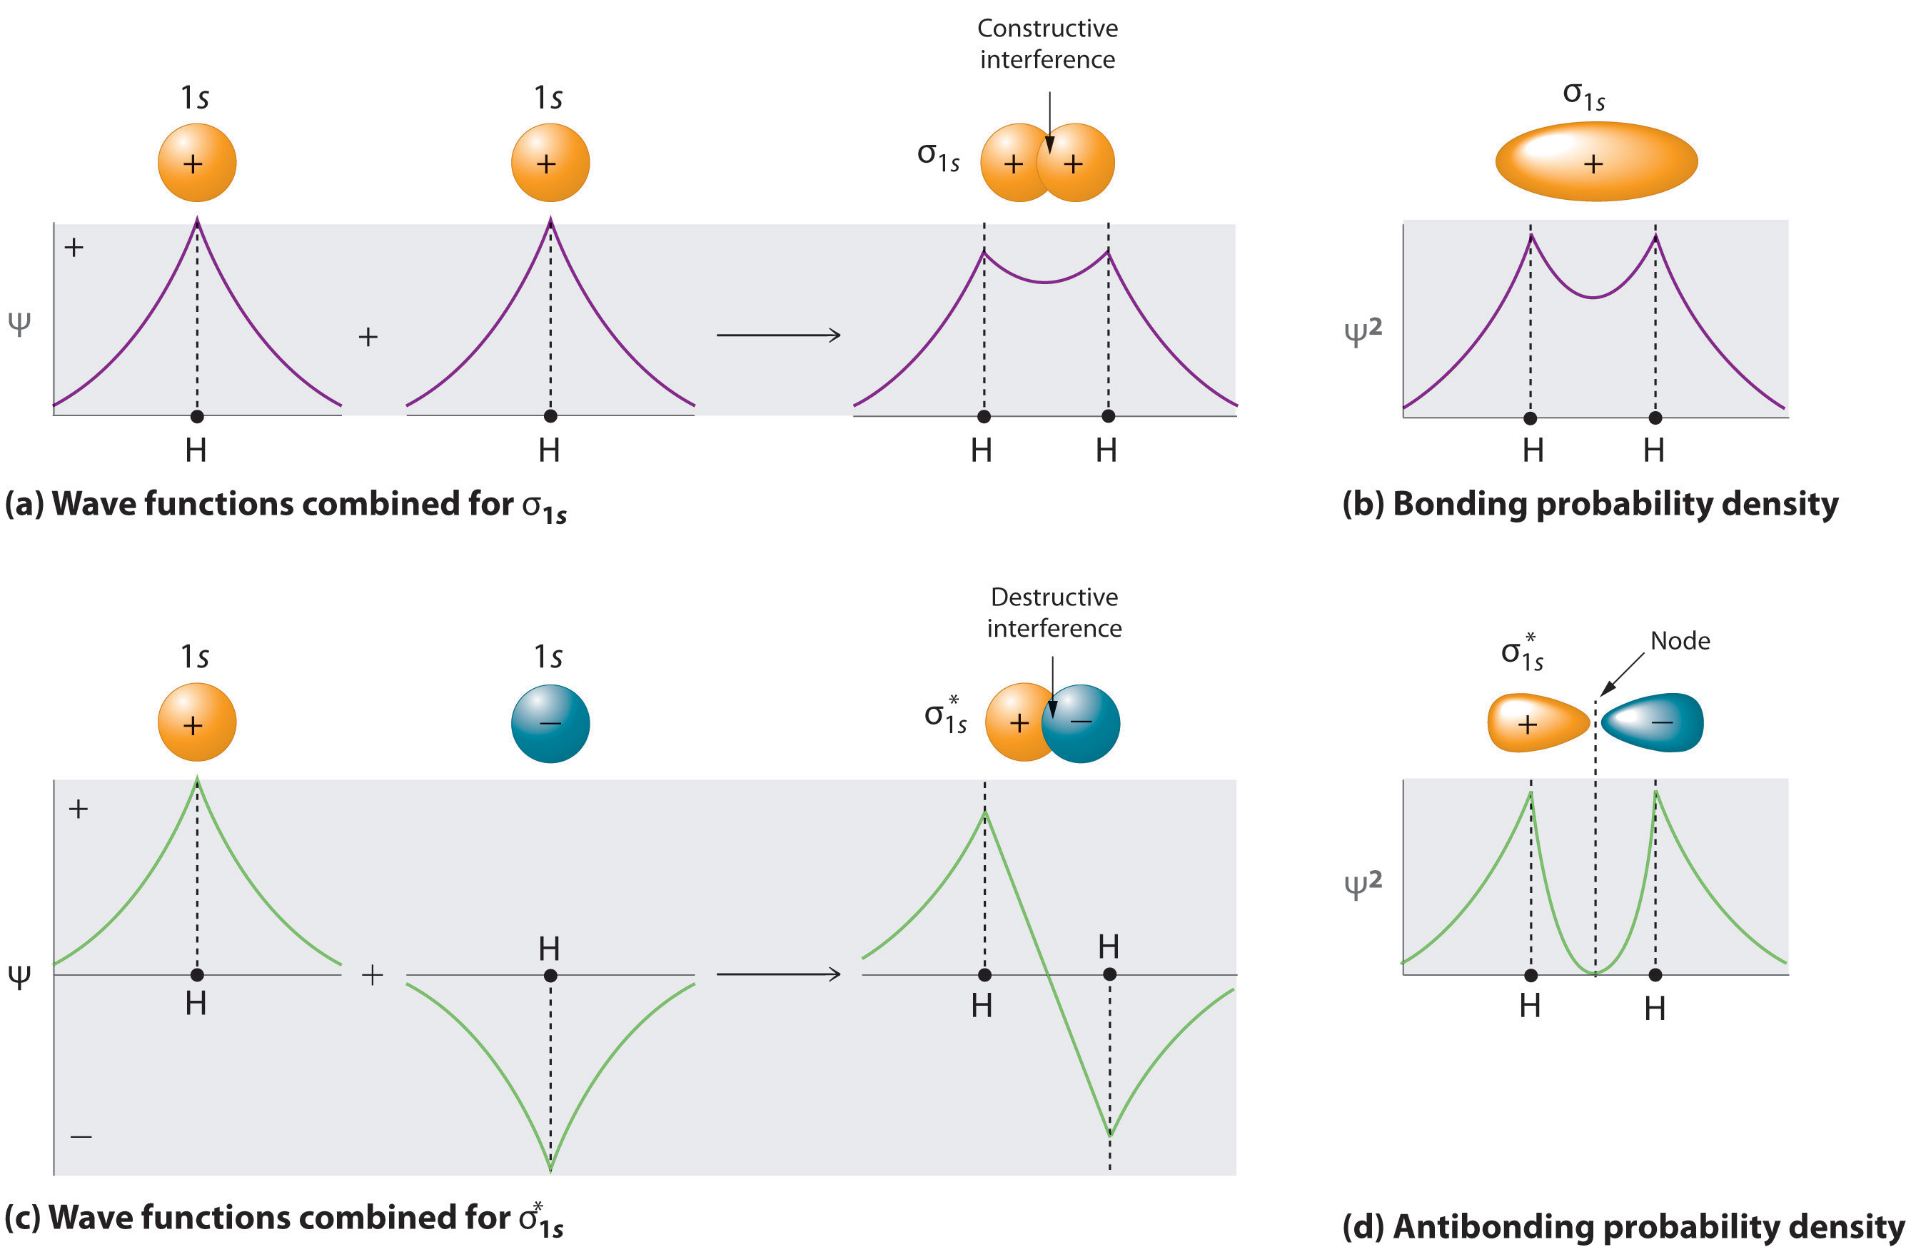

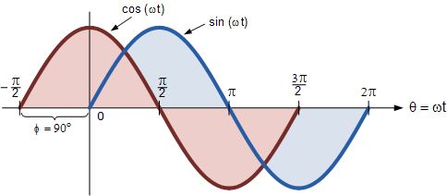
Molecular Orbitals
Recall: Electrons exhibit particle- and wave-like properties (de Broglie).
Recall: Waves exhibit periodicity, meaning they have phase(t).
Recall: Molecular orbitals result from a linear combination of atomic orbitals.

Slide 4
Molecular Orbitals cont.
Concept Check: Consider two fully conjugated polyene chains (C_{n}H_{n+2}).
Which system will be excited by longer wavelength light?
How can you connect this to the MO diagrams and the figure shown below?

Slide 5
Questions?

Slide 6
Q1
In a protein, a basic structural unit is the amide linkage, -C_{ɑ}-C(O)-N-C_{ɑ}-, where C_{ɑ} represents a carbon at the ɑ position to the carbonyl group. A key clue to the solution of the three-dimensional structure of proteins was the realization that the six atoms shown lie in a plane.
Explain why the planar structure is expected.
What are the expected bond angles between adjacent bonds?
Can you propose sketches of any molecular orbitals, and how many electrons are available to participate in π-type molecular orbitals.

Slide 7
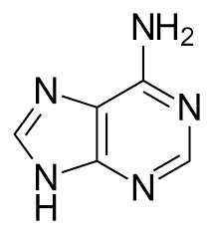
Q2
The nucleic acid-base adenine is a planar aromatic molecule containing 70 electrons, of which 20 are core electrons. The σ bonding around each aromatic C and N can be represented by sp² hybrid orbitals.
How many electrons are there in the conjugated system? State which atoms contribute one or two electrons.
How many bonding and antibonding MOs are there in adenine if we consider linear combinations of 2s and 2p AOs only?

Slide 8
Q2 cont.
Space
Space
How many MOs of the other types derived from 2s and 2p AOs are there in adenine?
Which atoms, if any, have nonbonding orbitals localized on them?

Slide 9
Questions?
Have a good weekend!

